Slide 1

Information Security

Slide 2
Objective:
To Introduce the need of Information Security
and its model
To understand programmatic vulnerabilities
and Session hijacking

Slide 3
Outline: contd..
Security Attacks (Interruption, Interception, Modification and Fabrication)
Security Services (Confidentiality, Authentication, Integrity, Non-repudiation, access Control and Availability)
Mechanisms
A model for Internetwork security
Internet Standards
RFCs RFC documents contain technical specifications and organizational notes for the Internet.

Slide 4
Security Attacks
Interruption,
Interception,
Modification and
Fabrication

Slide 5
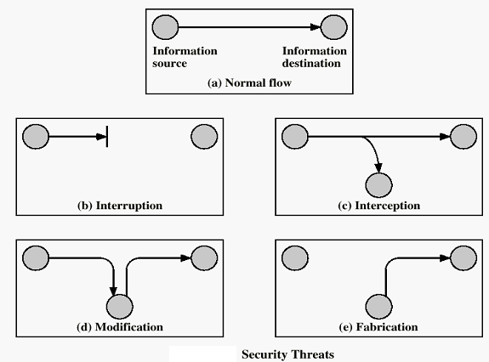


Slide 6
Interruption: This is an attack on availability
Interception: This is an attack on confidentiality
Modification: This is an attack on integrity
Fabrication: This is an attack on authenticity

Slide 7
Security Goals
Confidentiality
Availability
Integrity
Authenticity

Slide 8
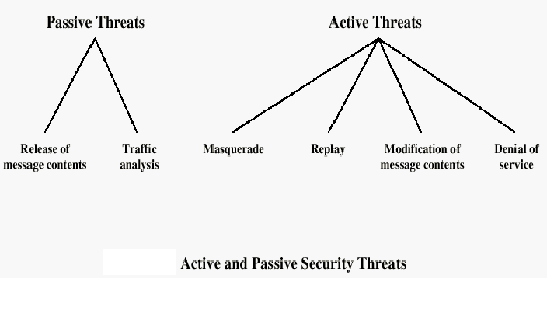
*A masquerade attack is an attack that uses a fake identity, such as a network identity

Slide 9
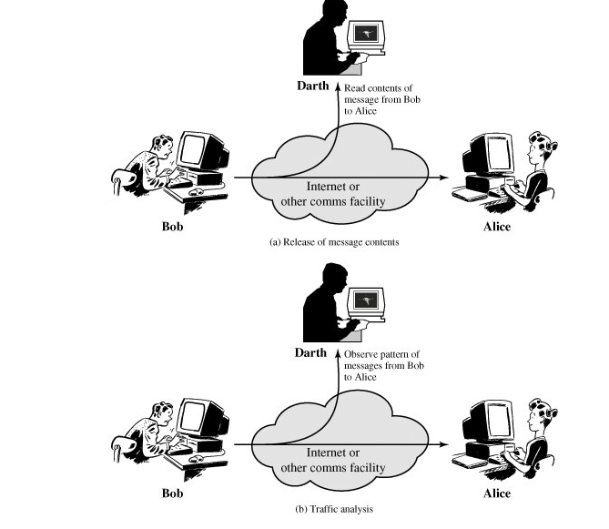

Slide 10
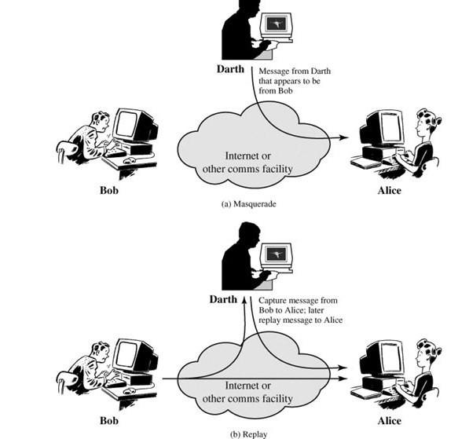

Slide 11
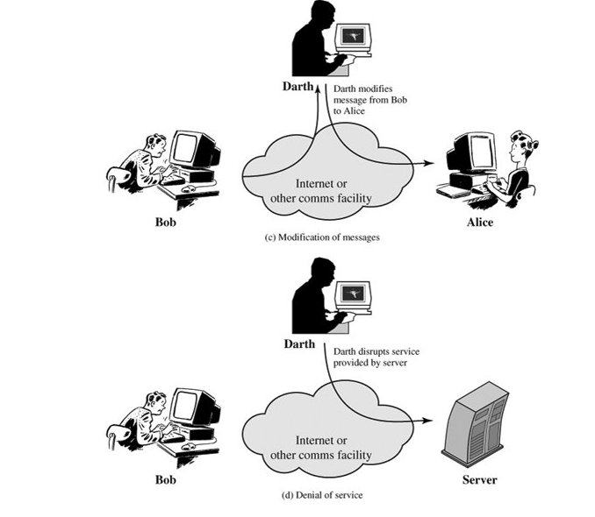

Slide 12
Security Services
Confidentiality,
Authentication,
Integrity,
Non-repudiation,
Access Control and
Availability

Slide 13
Security Services
Confidentiality (privacy)
Authentication (who created or sent the data)
Integrity (has not been altered)
Non-repudiation (the order is final)
Access control (prevent misuse of resources)
Availability (permanence, non-erasure)
  Denial of Service Attacks
  Virus that deletes files

Slide 14
Mechanisms
encryption
Digital Signatures
Access Control
Data Integrity
Authentication Exchange
Traffic Padding
Trusted Functionality

Slide 15
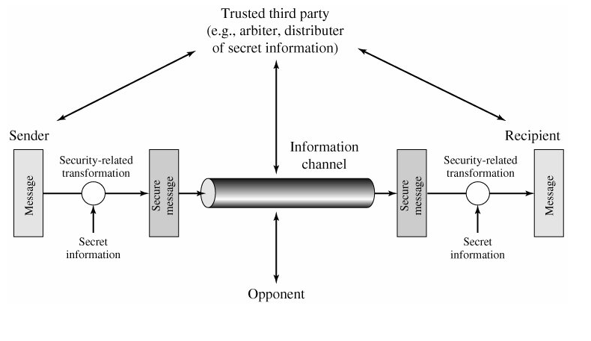
A model for Internetwork Security

Slide 16
Internet Standards
WHO :
Internet architecture Board
Internet Engineering Task Force
Internet Engineering Steering Group
Types:
Technical
Applicability

Slide 17
RFC
RFC Publication Process
Proposed standard
Draft standard
Internet standard

